Slide 1
UW SOM MENTORSHIP PROGRAM

Slide 2
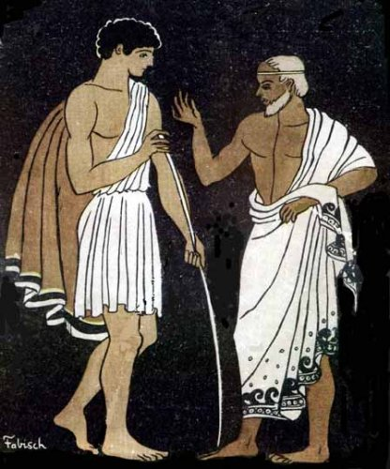
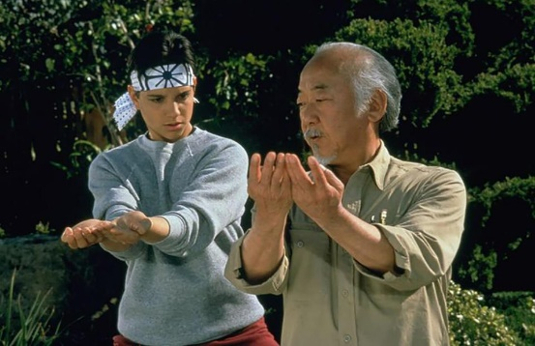
MENTOR
Definition: an experienced and trusted adviser; an experienced person in a company, college, or school who trains and counsels new employees or students
Origin: mid 18th century: via French and Latin from Greek Mentōr, the name of the adviser of the young Telemachus in Homer's Odyssey
Popular Culture:
Jaime Escalante in Stand and Deliver
Mr. Miyagi in Karate Kid
Mufasa in The Lion King

Slide 3
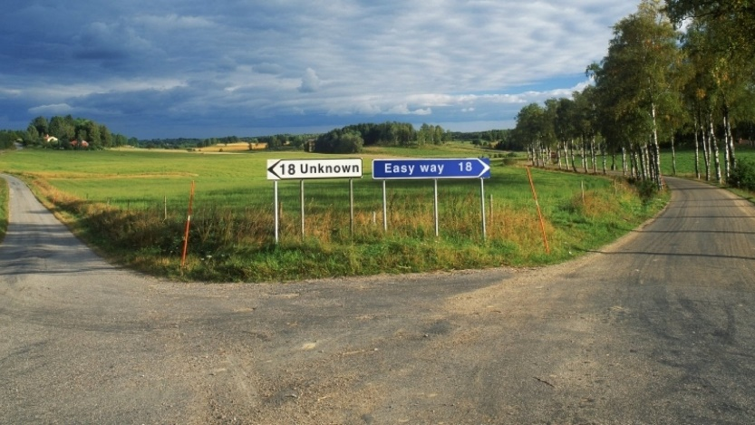
MENTEE
Why does UW SOM need mentees?
Continuity in the system
Investment in current managers and leaders
Mentors gain from the relationship as well
Improves the organization
Enhances SOM culture
https://mentorship.uw.edu/about/our-mission
Why do you want to be
a mentee?
Notes:
Interaction with group

Slide 4
MENTOR
How does the matching process work?
Mentees will create priority list of preferred mentors (9/22 deadline)
Mentors and mentees will meet over Zoom (by 10/2 EOD)
Opportunity for mentees to ask questions and get to know prospective mentors
Mentors complete survey to select mentee(s) based on meetings
Mentorship committee will create matches based on preferences (Program will begin in October)
Mentors to have one or two mentees
Not all mentee applicants will match

Slide 5
MENTEE
What is asked of mentees?
Time
One hour per month with mentor
Schedule meetings and create a meeting agenda
Communication
Keep an open mind and consider advice
Confidentiality is assumed- this is a safe space
As with all relationships boundaries are appropriate and important
Ask questions!
What if it isn’t a good fit?
The hope is that the match is mutually beneficial
Mentorship Committee open to feedback and assisting with resolution
Notes:
Mentees are in the driver’s seat

Slide 6
MENTOR / MENTEE
Resources
Quick Reference for Existing or Potential Mentees at the UW https://mentorship.uw.edu/about/faqs
UW SOM Mentorship Program Presentation
HBR Article: What Efficient Mentorship Looks Like
Web Article: How to be a Good Mentee
https://www.insala.com/blog/how-to-be-a-good-mentee

